Slide 1


Sharks and bony fish: The K-Pg crisis as turnover event?
Analytical Paleobiology Project
Isabella Leonhard
03/08/2020

Slide 2
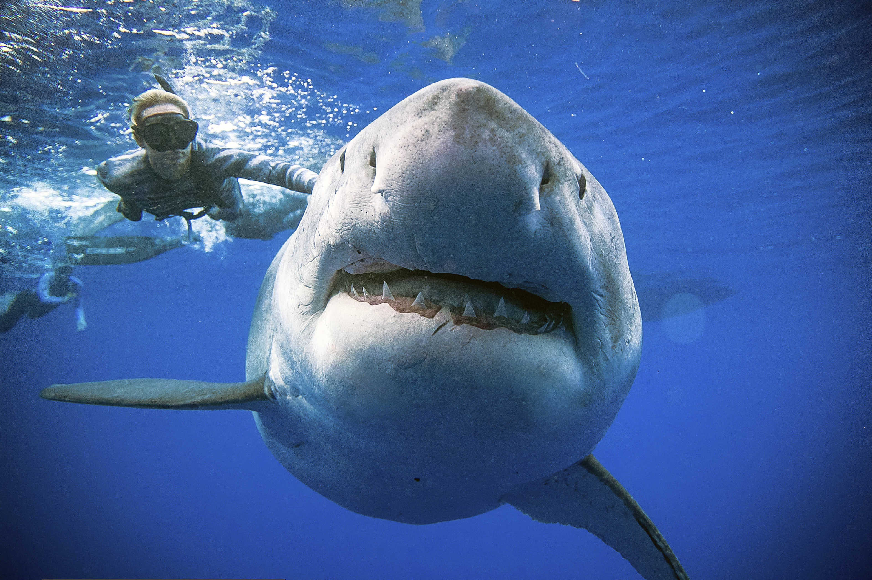
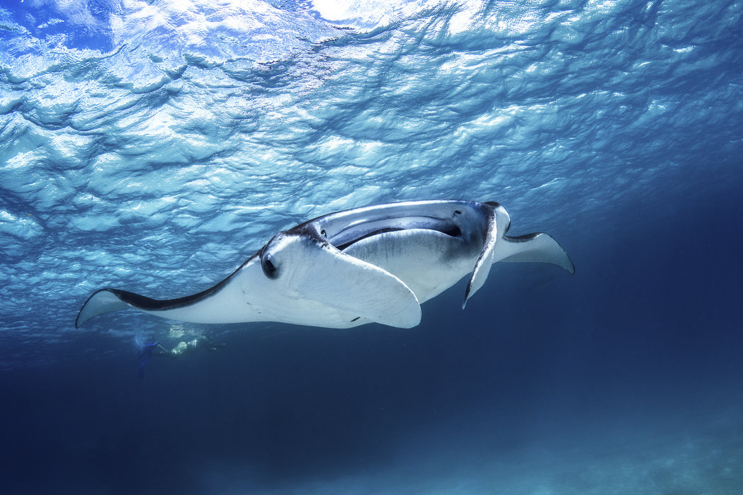
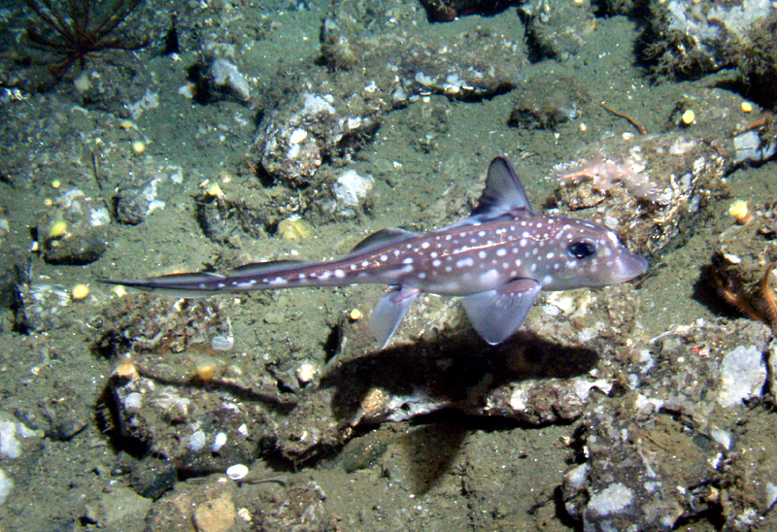
Introduction: Chondrichthyes (cartilaginous fish)
Elasmobranchii
Holocephali
Source: sharkthrust

Slide 3
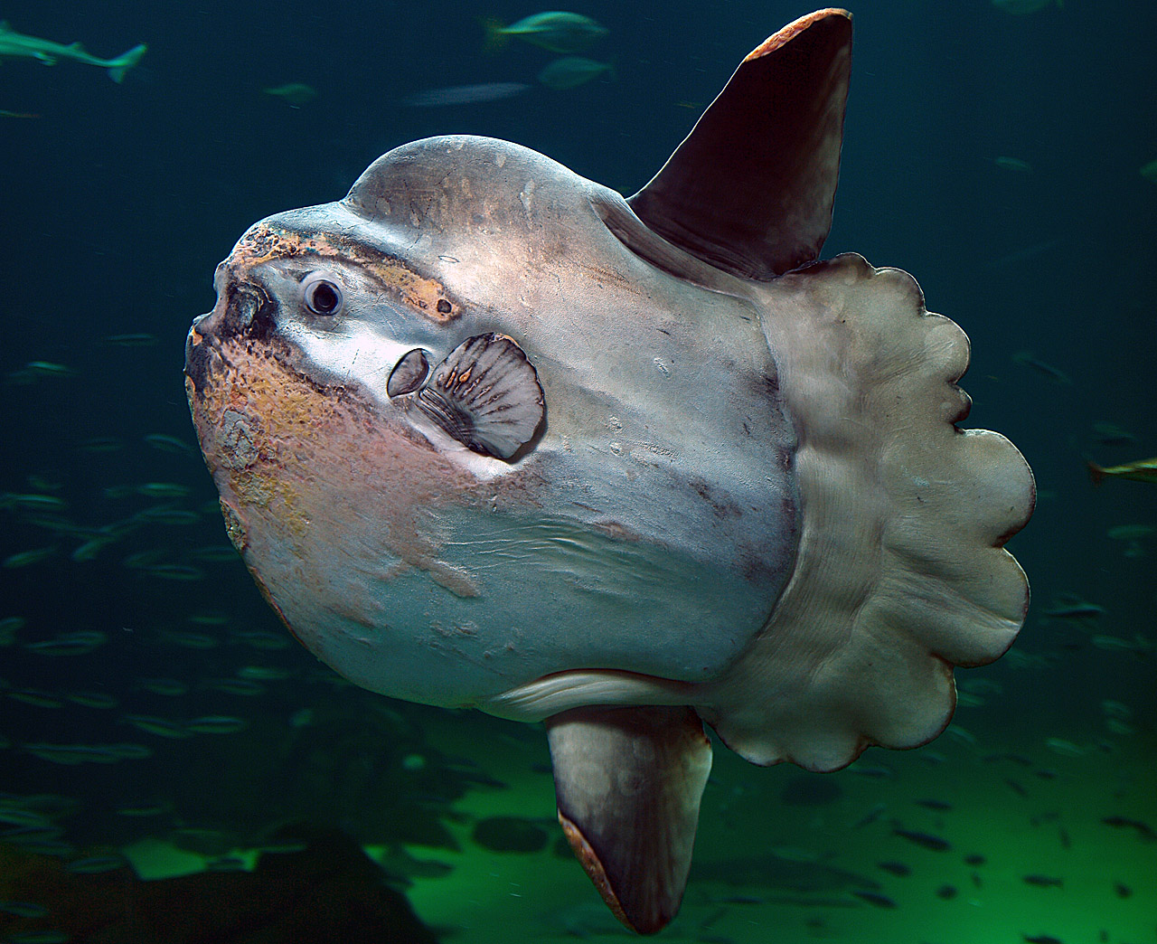
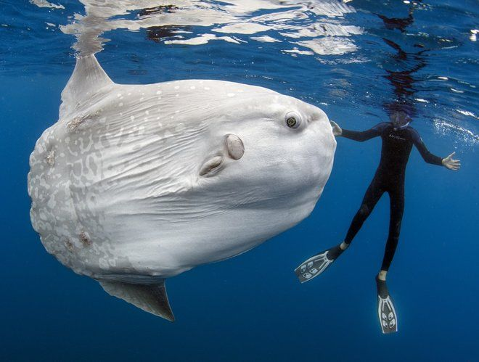
Introduction: Osteichthyes (bony fish)
Source: LifeScience.com
Source: Wikipedia

Slide 4
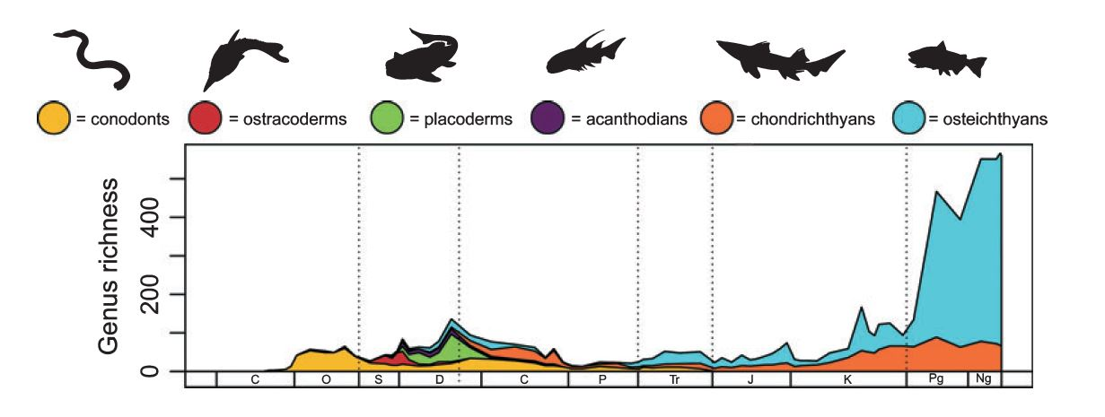
Diversity patterns of fishes during Phanerozoic
Friedman and Sallan, 2012, based on Sepkoski`s (2002) compendia of marine vertebrata

Slide 5
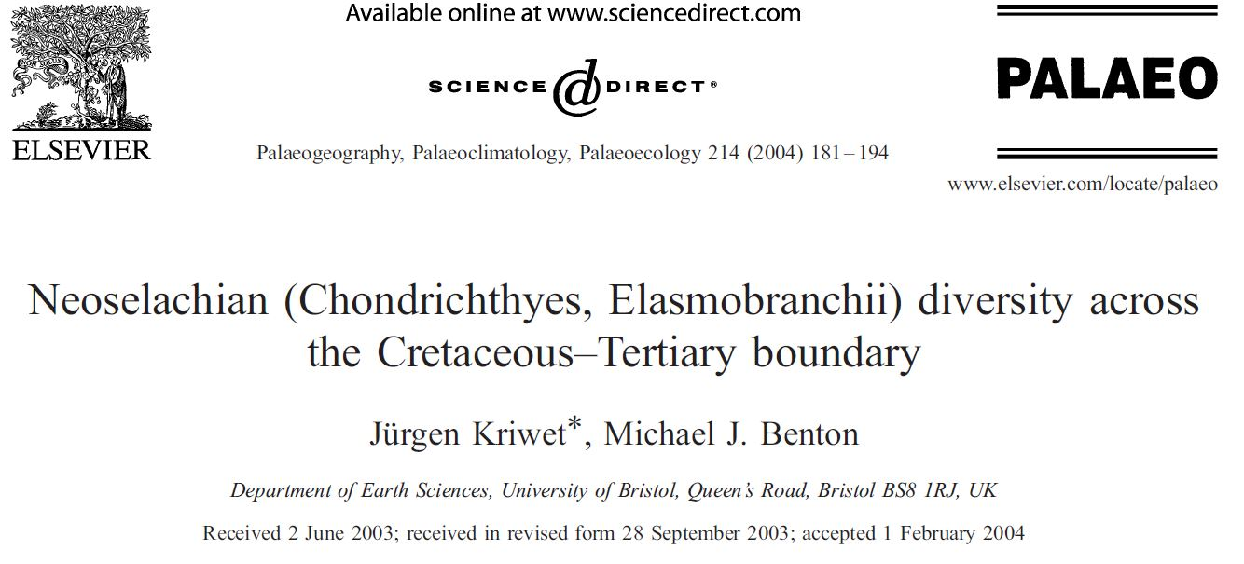
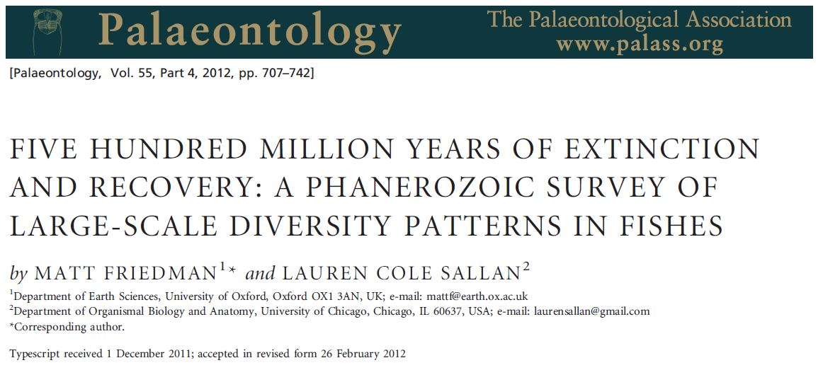
Extinction/recovery pattern within neoselachian elasmobranchii on global scale: +17% of all families went extinct
Large-scale diversity pattern of fish
Reliability of our diversity pattern

Slide 6
Hypothesis
Chondrichthyes (Sharks) as dominant predators were massively affected at the K-Pg boundary
The K-Pg event as key event for the evolution of our modern sharks ?
Diversification of Ground Sharks (Carachiniformes) in Paleogene?

Slide 7
Objective
How much differ origination and extinction patterns between the two classes Chondrichthyes and Osteichthyes by using occurrence data from PBDB?

Slide 8


Data & Methods
Source: PBDB
Occurrence data of Chondrichthyes and Osteichthyes
Software: R Studio
Data processing, plotting

Slide 9
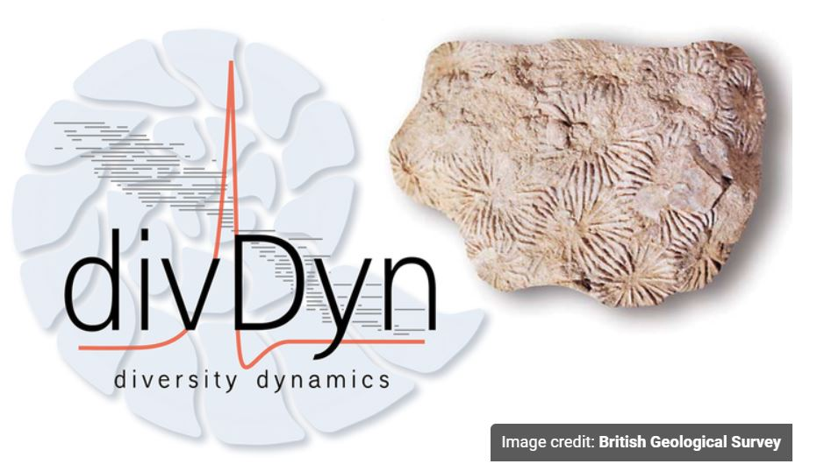
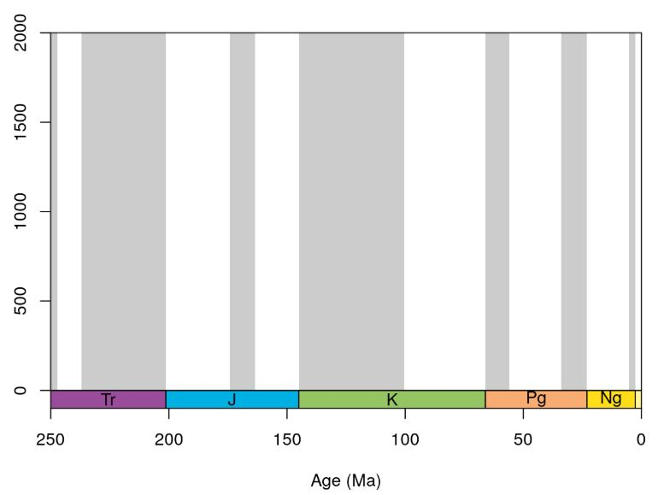
Data & Methods
Packages: divDyn
Data processing and
Sampling assessment
Subsampling: CR (q=20), SQS
Plotting within time-scale plots

Slide 10
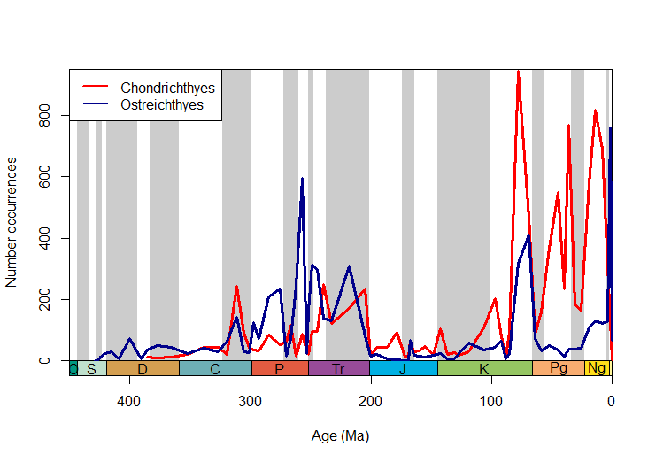
Results: Occurrence data

Slide 11
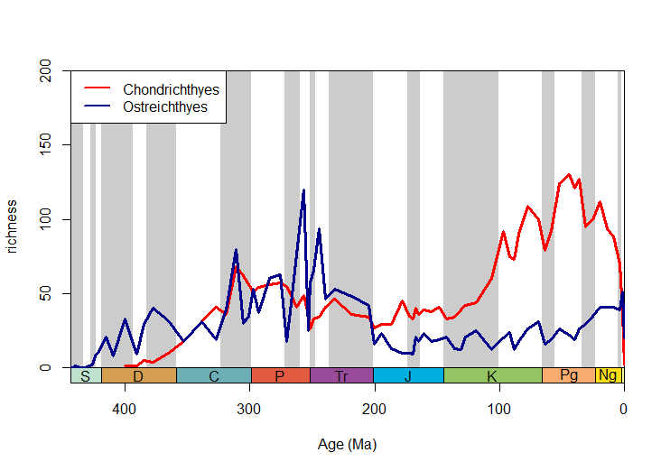
Results: Simple diversity

Slide 12
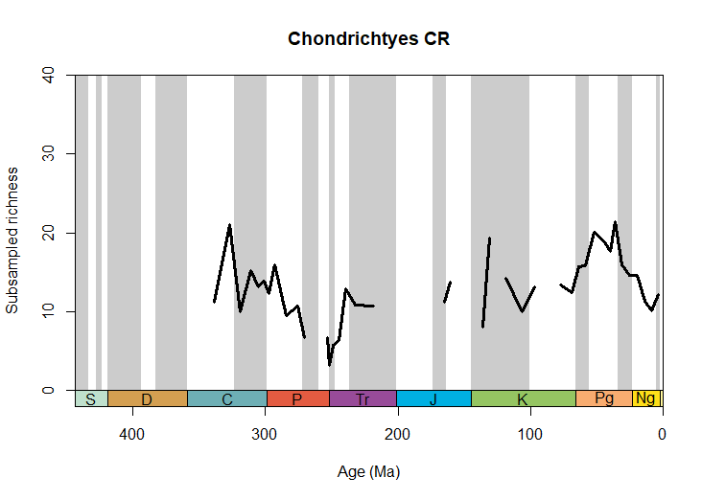
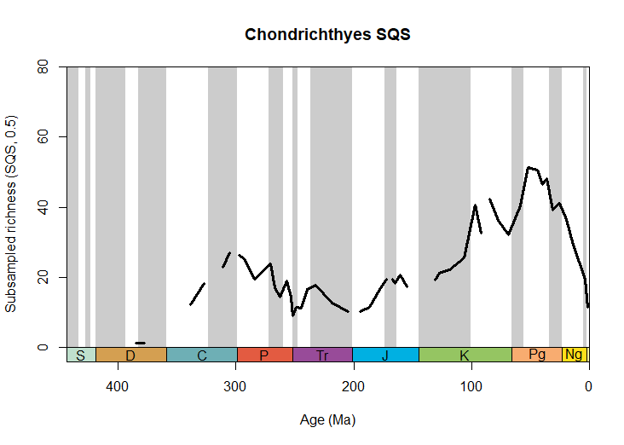
Results: Subsampling CR and SQS

Slide 13
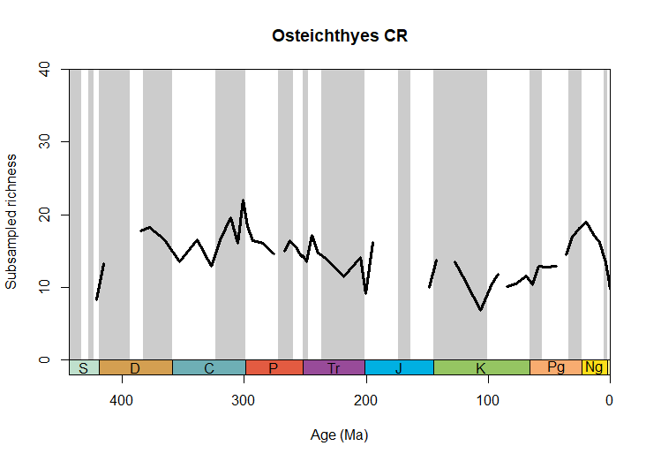
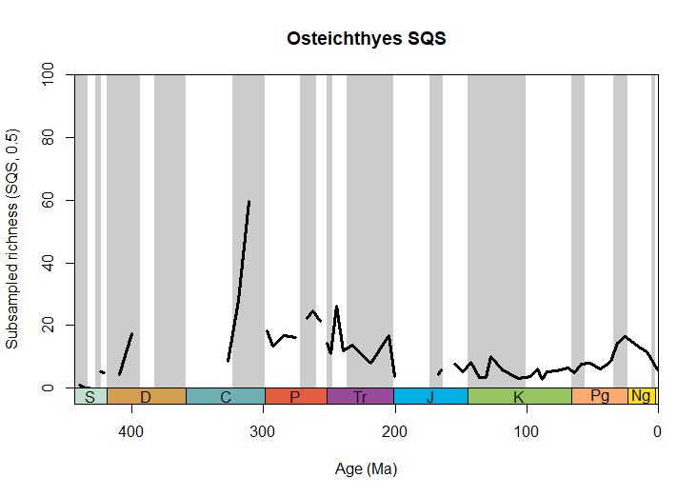
Results: Subsampling CR and SQS

Slide 14
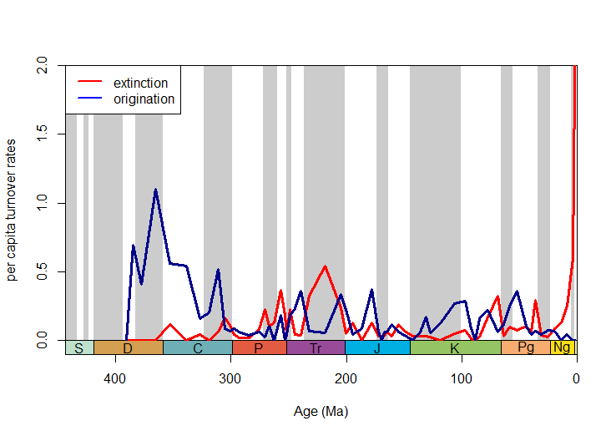
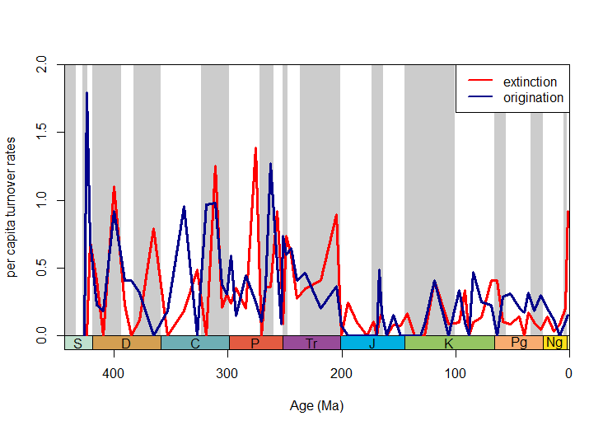
Results: Turnover rates
Chondrichthyes
Osteichthyes

Slide 15

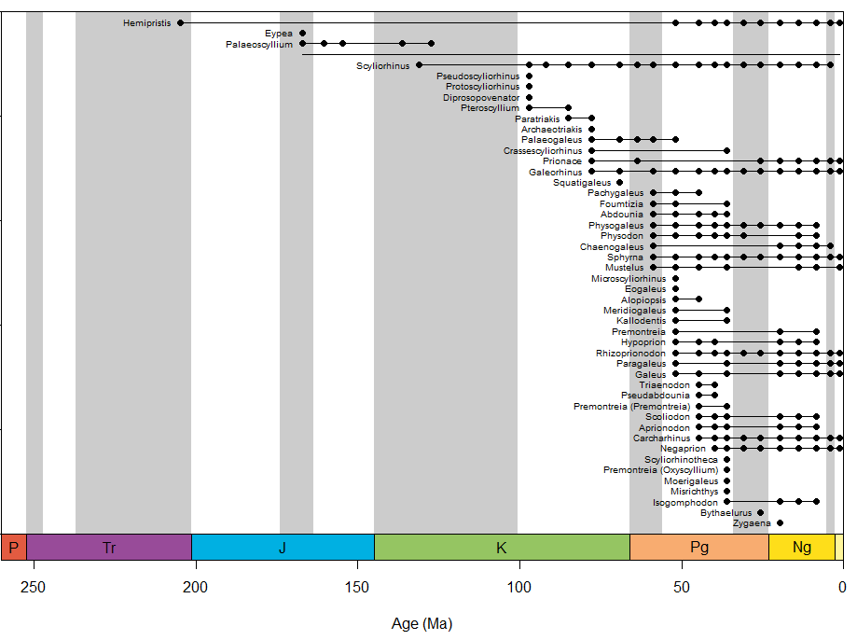
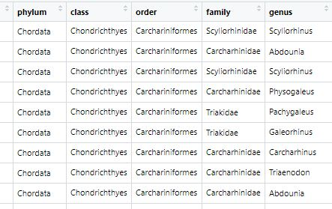
Results: Ground Sharks - Pattern of ranges

Slide 16
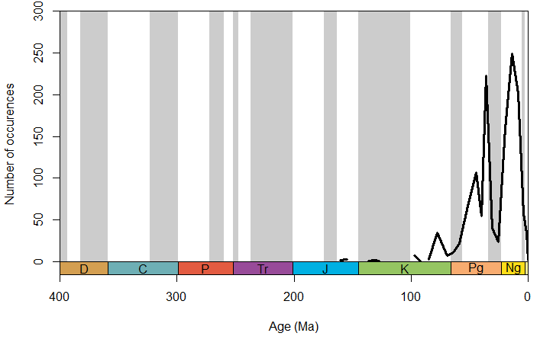
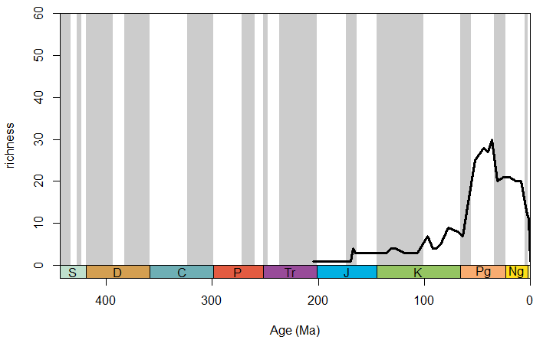
Results: Ground Sharks
Occurrence data
Simple diversity

Slide 17
Conclusion
Chondrichthyes (Sharks in particular) as dominant predators were massively affected at the K-Pg boundary

Slide 18
Conclusion
Chondrichthyes (Sharks in particular) as dominant predators were massively affected at the K-Pg boundary
No massive decrease in diversity; K-Pg mass extinction seems to be key event in our modern shark evolution!
Carachiniformes : Diversification in the Paleogene

Slide 19
Conclusion
Chondrichthyes (Sharks in particular) as dominant predators were massively affected at the K-Pg boundary
Rapid evolution after the K-Pg event towards our modern sharks
How much differ the origination and extinction pattern between the two classes Chondrichthyes and Osteichthyes?

Slide 20
Conclusion
Chondrichthyes (Sharks in particular) as dominant predators were massively affected at the K-Pg boundary
Rapid evolution after the K-Pg event towards our modern sharks
How much differ the origination and extinction pattern between the two classes Chondrichthyes and Osteichthyes?
The difference is not massive, BUT the increase in diversity after the K-Pg mass extinction in Chondrichthyes is higher
The turnover rates in Osteichthyes are more fluctuating than in Chondrichthyes

Slide 21
Some last thoughts
PBDB is not optimal for vertebrate occurrence data
Peaks throughout diversity curves: more sampling issues than real fluctuations?!
K-Pg mass extinction: “Non-event for fishes?” (MacLeod 1997)

Slide 22
Thank you!

Slide 23

References & further reading
Kriwet, J. and Benton, M.J. 2004. Neoselachian (Chondrichthyes, Elasmobranchii) diversity across the Cretaceous – Tertiary boundary. Palaeogeography, Palaeoclimatology, Palaeoecology, 214, 181 – 194.
Friedman, M., & Sallan, L. C. (2012). Five hundred million years of extinction and recovery: a Phanerozoic survey of large‐scale diversity patterns in fishes. Palaeontology, 55(4), 707-742.
Sibert, E. C., & Norris, R. D. (2015). New Age of Fishes initiated by the Cretaceous− Paleogene mass extinction. Proceedings of the National Academy of Sciences, 112(28), 8537-8542.
https://www.sharktrust.org/

Slide 24
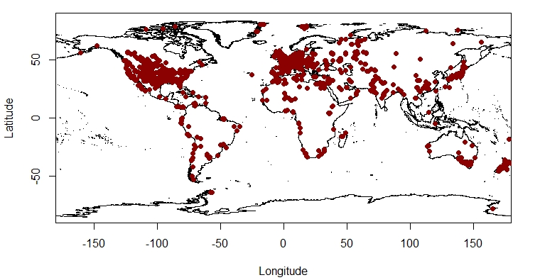
Addition: Chondrichthyes – occurrence pattern

Slide 25
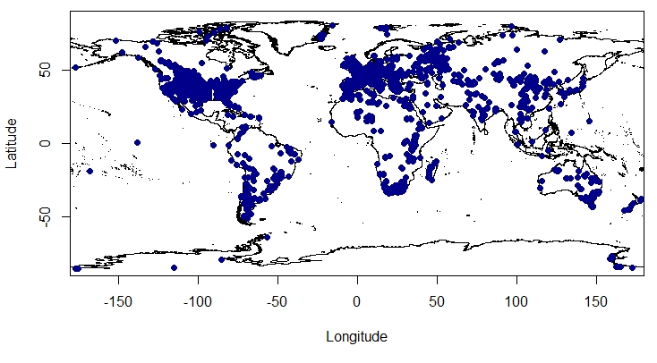
Addition: Osteichthyes – occurrence pattern

Slide 26
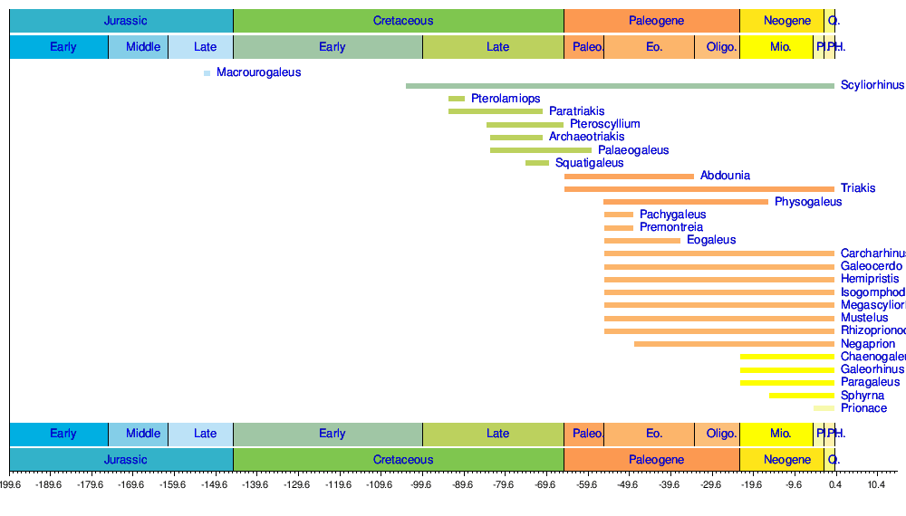
Addition:
Benton 2006

